Slide 1



Scalable Automatic Machine Learning in H2O
Michelle Tanco
Customer Data Scientist

Slide 2
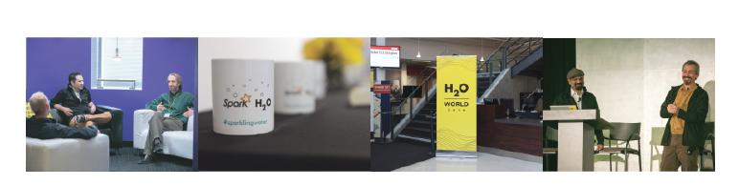
What is H2O?
H2O.ai, the company
Founded in 2012
Advised by Stanford Professors Hastie, Tibshirani & Boyd
Headquarters: Mountain View, California, USA
H2O, the platform
Open Source Software (Apache 2.0 Licensed)
R, Python, Scala, Java and Web Interfaces
Distributed Machine Learning Algorithms for Big Data

Slide 3

Agenda
Automatic Machine Learning (AutoML)
Scalable ML with the H2O Platform
H2O AutoML Overview
Resources
Slides ⬇️ https://tinyurl.com/h2o-meetups

Slide 4
Intro to Automatic Machine Learning

Slide 5

Problems to Automate: Supervised Learning
Regression:
Classification:
yes
no
y
x_{j}
X
x_{i}
How much will a customer spend?
How many dogs are in this picture?
How satisfied are my customers?
How many of each product do I need in each store for the next 10 weeks?
Will this customer make a purchase?
What type of animal is in this photo?
Will this customer file a claim?
Will this customer pay back their loan?
Which customer service agent should get this complaint?

Slide 6
Goals & Features of AutoML
🏆 Train the best model in the least amount of time
📉 Reduce the human effort & expertise required in machine learning
📈 Improve the performance of machine learning models
🔄 Increase reproducibility & establish a baseline for scientific research or applications

Slide 7
Evolution of AutoML
03
Third Gen
02
Second Gen
“Excel easy” – Vertical solutions with automated data augmentation, automated data preparation, new algorithms
Iterative learning approach with automatic feature engineering, model interpretability, and model stacking
01
First Gen
Model showdown with hyper-parameter tuning and ensembles
01
02
03

Slide 8







Aspects of [Automatic] Machine Learning
Model Generation
Data Prep
Ensembles

Slide 9
Aspects of Automatic Machine Learning
Data Preprocessing
Imputation, one-hot encoding, standardization
Feature selection and/or feature extraction (e.g. PCA)
Count/Label/Target encoding of categorical features
Model Generation
Cartesian grid search or random grid search
Bayesian Hyperparameter Optimization
Neural Architecture Search (NAS)
Ensembles
Ensembles often out-perform individual models
Stacking / Super Learning (Wolpert, Breiman)
Ensemble Selection (Caruana)

Slide 10
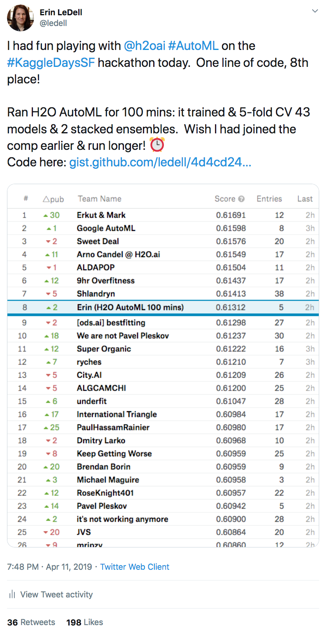
Will AutoML Take My Job?!
On a one-day Kaggle competition, AutoML tools ruled the leaderboard
In regular competitions, teams have much more time to do sophisticated, hand-crafted feature engineering, and so the humans are still winning (for now… 😈)
AutoML tools give the data scientist more time to focus on more complicated projects, understanding the domain, and getting more models into production or otherwise impacting the business
https://twitter.com/ledell/status/1116533416155963392

Slide 11
[Not-So-Automatic] Aspects of Machine Learning
Model Trust
Domain Expertise
Taking Action

Slide 12
H2O Platform

Slide 13






H2O Machine Learning Platform
Distributed (multi-core + multi-node) implementations of cutting edge ML algorithms
Core algorithms written in high performance Java
APIs available in R, Python, Scala; web GUI
Easily deploy models to production as pure Java code
Works on Hadoop, Spark, EC2, your laptop, etc.

Slide 14
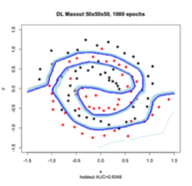


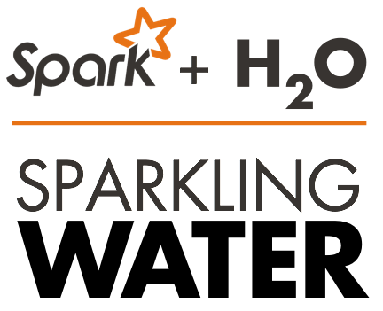


H2O Open Source AI Platform
Open Source
Big Data Ecosystem
Flexible Interface
Smart and Fast Algorithms
100% open source
H₂O Flow
Scalability and Performance
Rapid Model Deployment
GPU Enablement
Cloud Integration
Highly portable models deployed in Java (POJO) and Model Object Optimized (MOJO)
Automated and streamlined scoring service deployment with Rest API
Distributed in-memory computing platform
Distributed algorithms
Fine-grain MapReduce

Slide 15

H2O Machine Learning Features
Supervised & unsupervised machine learning algos (GBM, RF, DNN, GLM, Stacked Ensembles, etc.)
Imputation, normalization, & auto one-hot-encoding
Automatic early stopping
Cross-validation, grid search, & random search
Variable importance, model evaluation metrics, plots

Slide 16
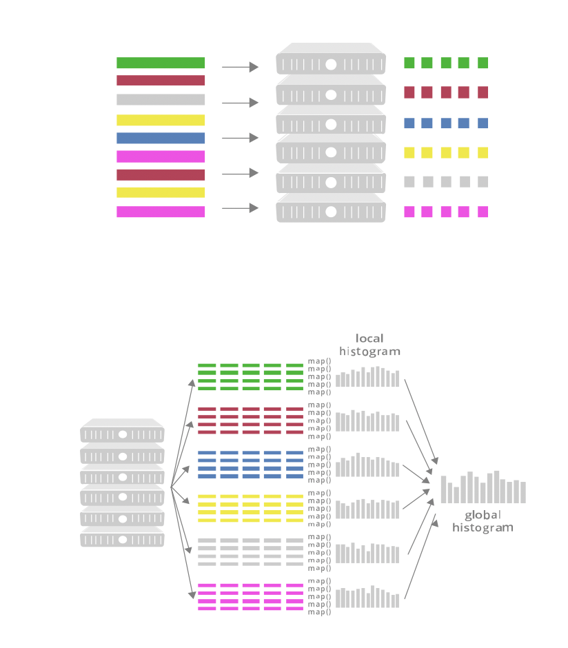
Machine Learning at Scale
Parallelize data storage across CPUs and Nodes
Rule of thumb: memory = 4x data size
Map Reduce to run ML algorithms distributed across the cluster

Slide 17













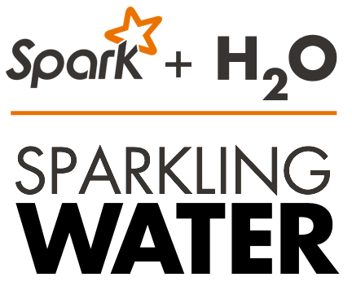



Machine Learning at Scale
Production
Environments
REST / JSON
HDFS
Parse
Exploratory
Analysis
ML
Algorithms
Scoring
POJO
S3
Feature
Engineering
Model
Evaluation
Data / Model
Export
Local
Fluid Vector Frame
Job
NFS
Distributed K/V Store
MRTask
Non-Blocking Hash Table
Distributed Fork / Join
SQL
Distributed In-Memory Processing

Slide 18
H2O’s AutoML

Slide 19
H2O AutoML (v3.26)
Data Preprocessing
Imputation, one-hot encoding, standardization
Feature selection and/or feature extraction (e.g. PCA)
Count/Label/Target encoding of categorical features
Model Generation
Cartesian grid search or random grid search
Bayesian Hyperparameter Optimization
Individual models can be tuned using a validation set
Ensembles
Ensembles often out-perform individual models:
Stacking / Super Learning (Wolpert, Breiman)
Ensemble Selection (Caruana)

Slide 20
Random Grid Search & Stacking
Random Grid Search combined with Stacked Ensembles is a powerful combination and scales well
Ensembles perform particularly well if the models they are based on
are individually strong
make uncorrelated errors
Stacking uses a second-level meta-learning algorithm to find the optimal combination of base learners

Slide 21
H2O AutoML
Basic data pre-processing
Trains a random grid of GBMs, DNNs, GLMs, etc. using a carefully chosen hyper-parameter space
Individual models are tuned using cross-validation
Two Stacked Ensembles are trained (“All Models” ensemble & a lightweight “Best of Family” ensemble)
Returns a sorted “Leaderboard” of all models
All models can be easily exported to production

Slide 22
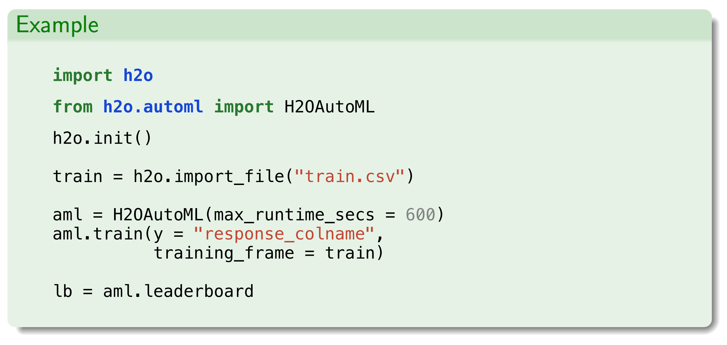
H2O AutoML in Python

Slide 23
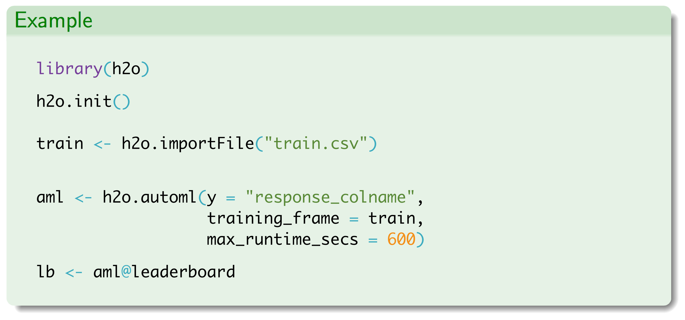
H2O AutoML in R

Slide 24
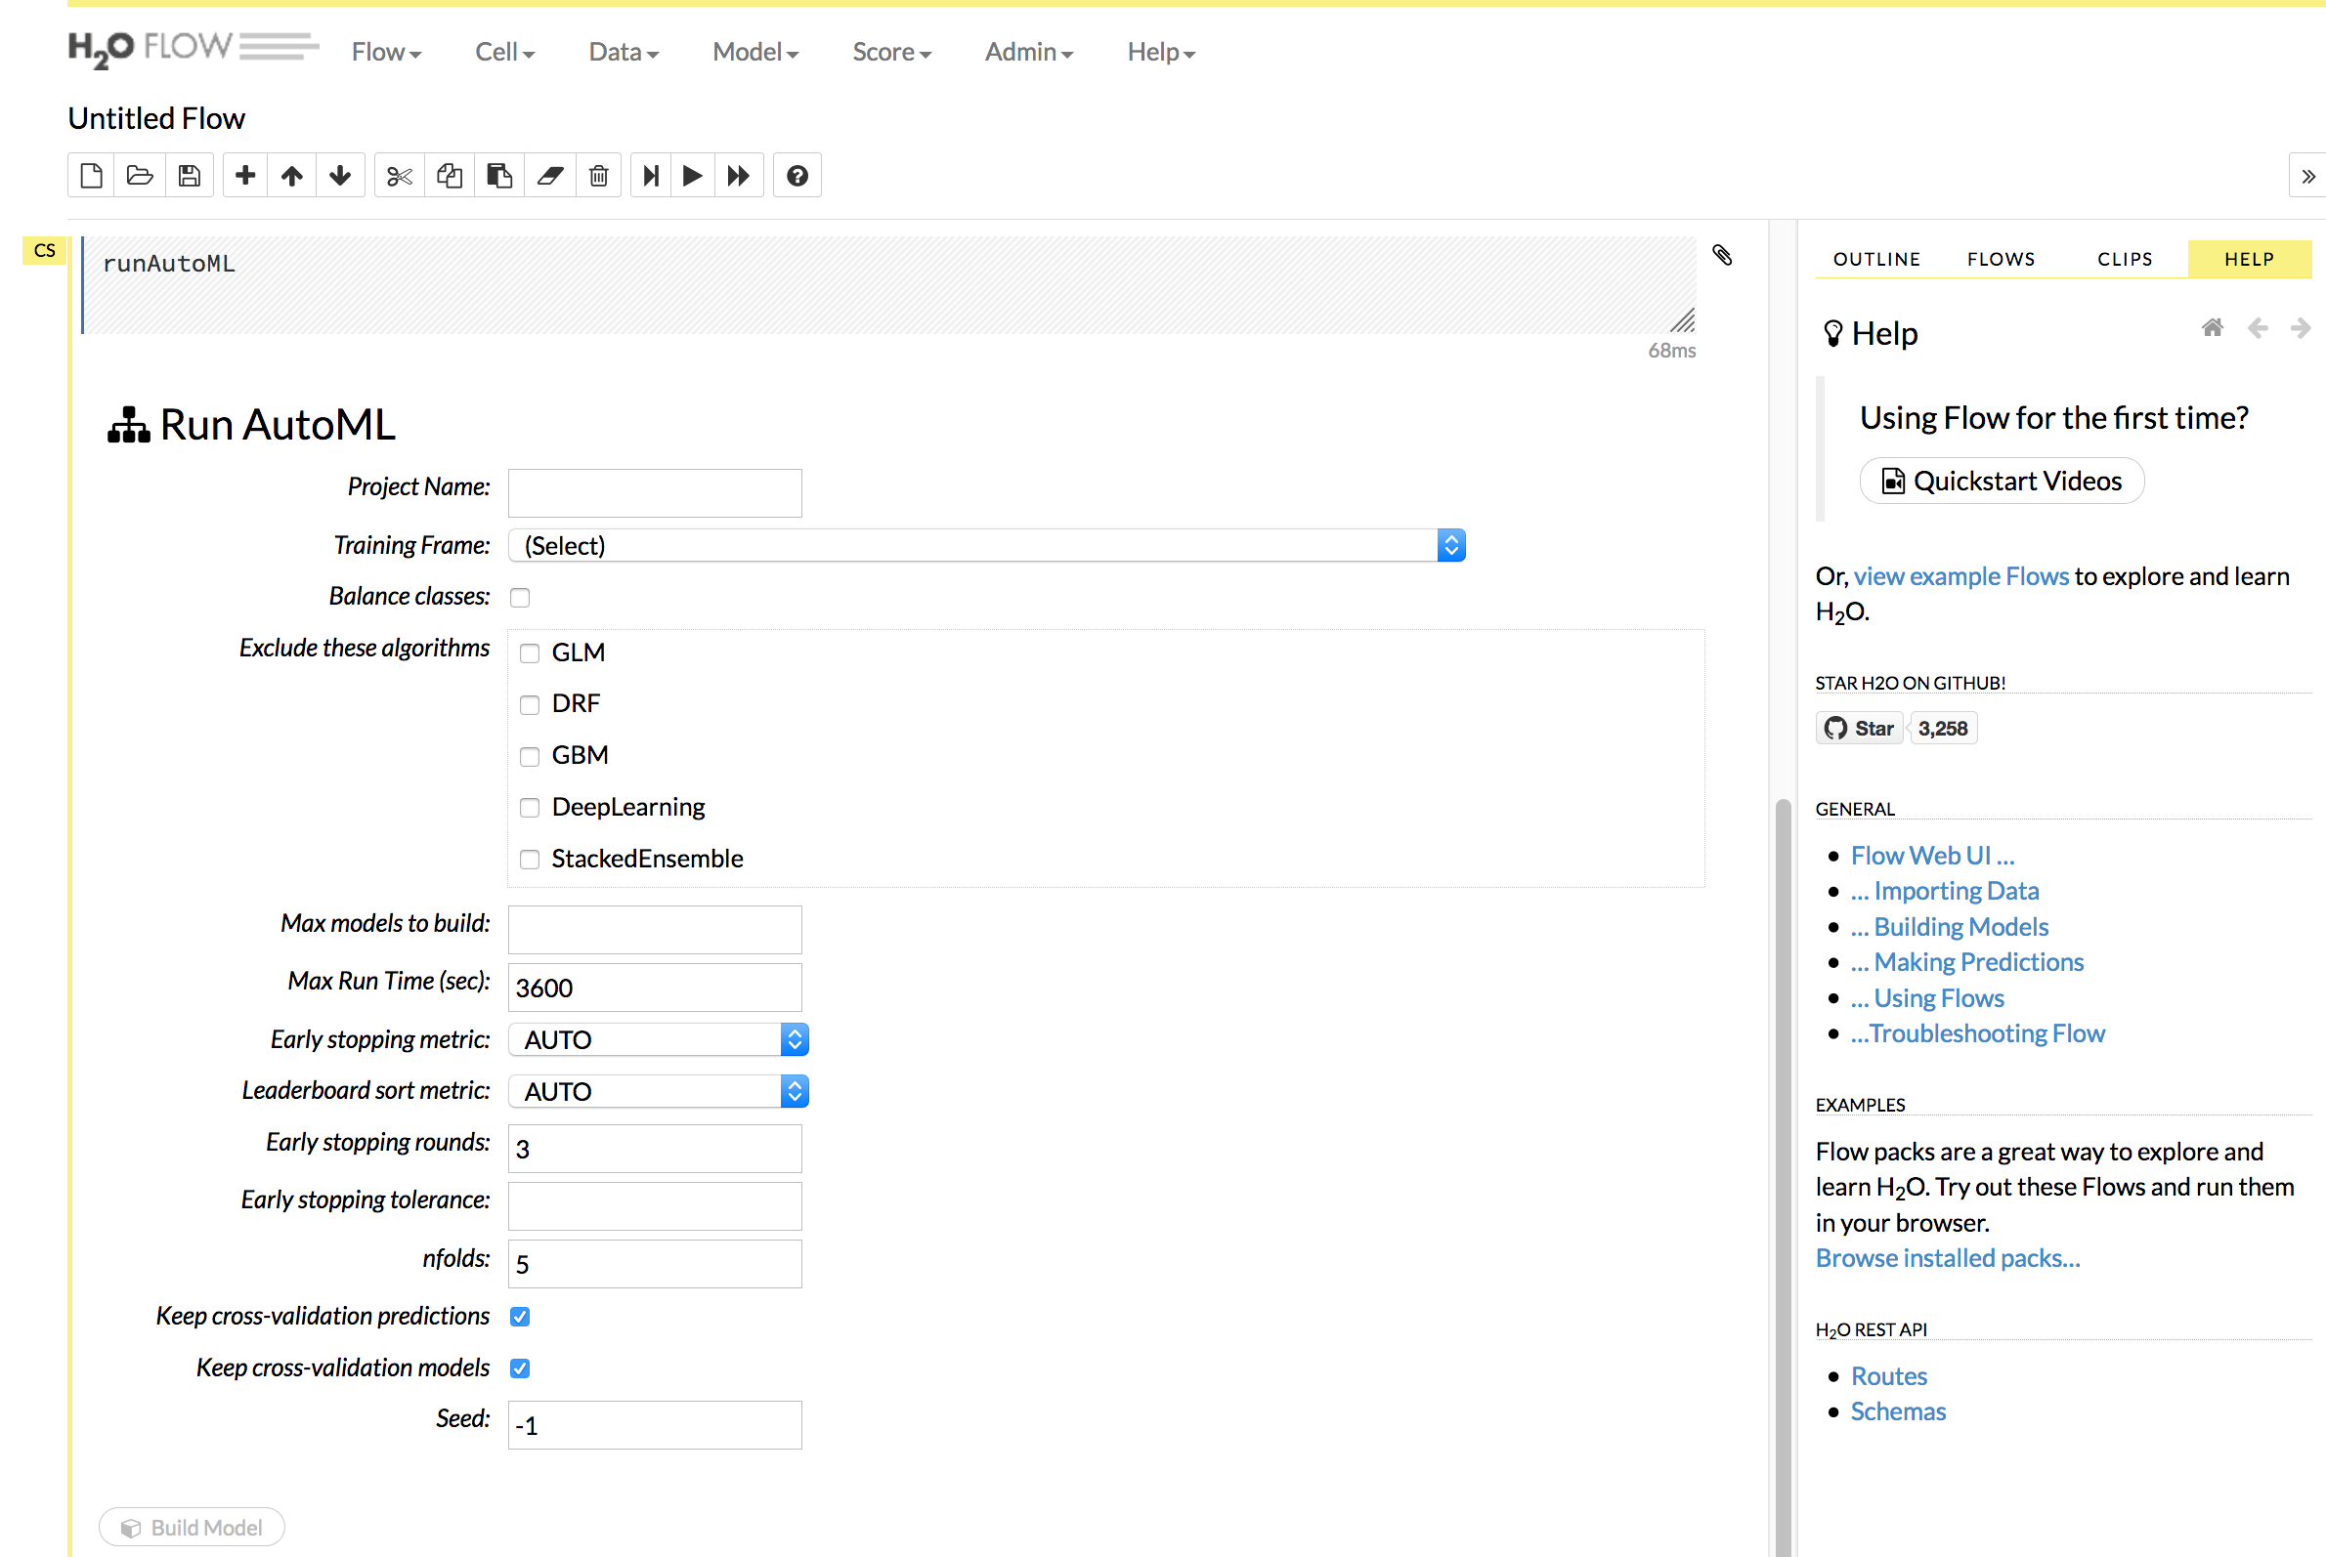
H2O AutoML in Flow GUI

Slide 25
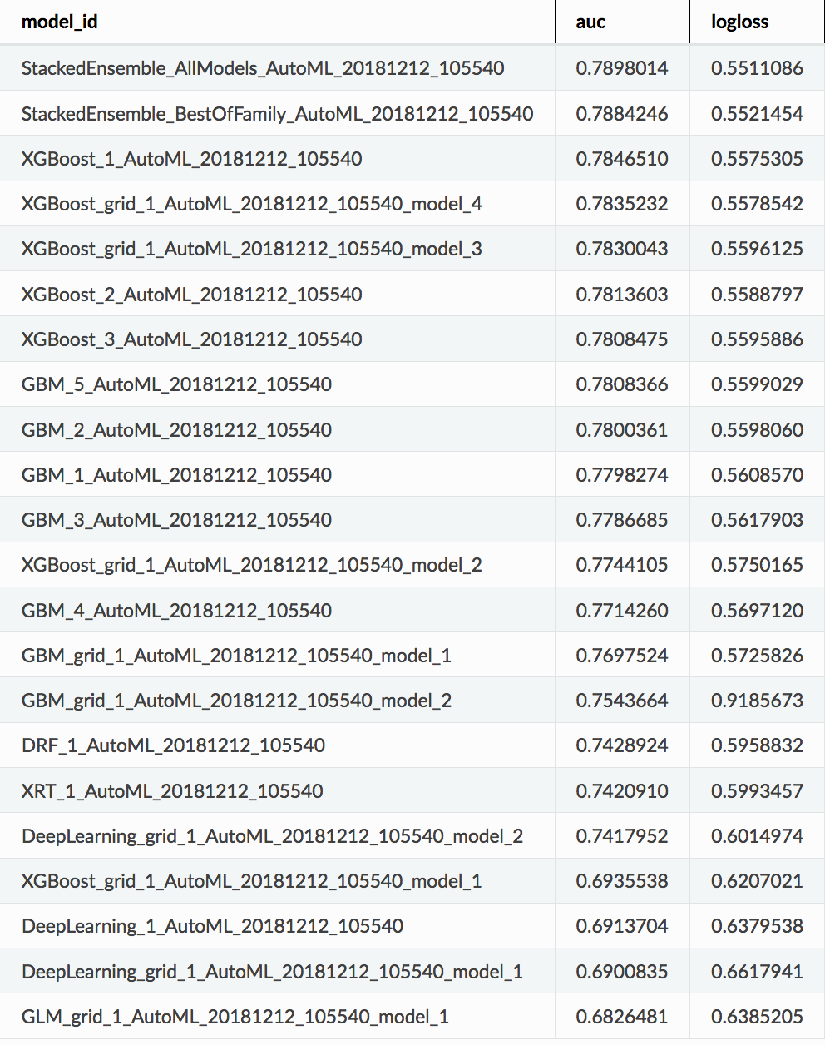
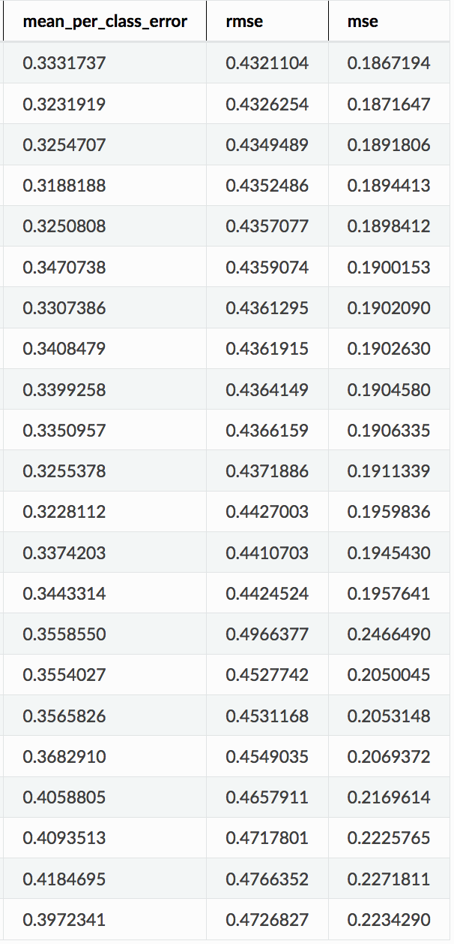

H2O AutoML Leaderboard
Example Leaderboard for binary classification
(Higgs 10k)

Slide 26
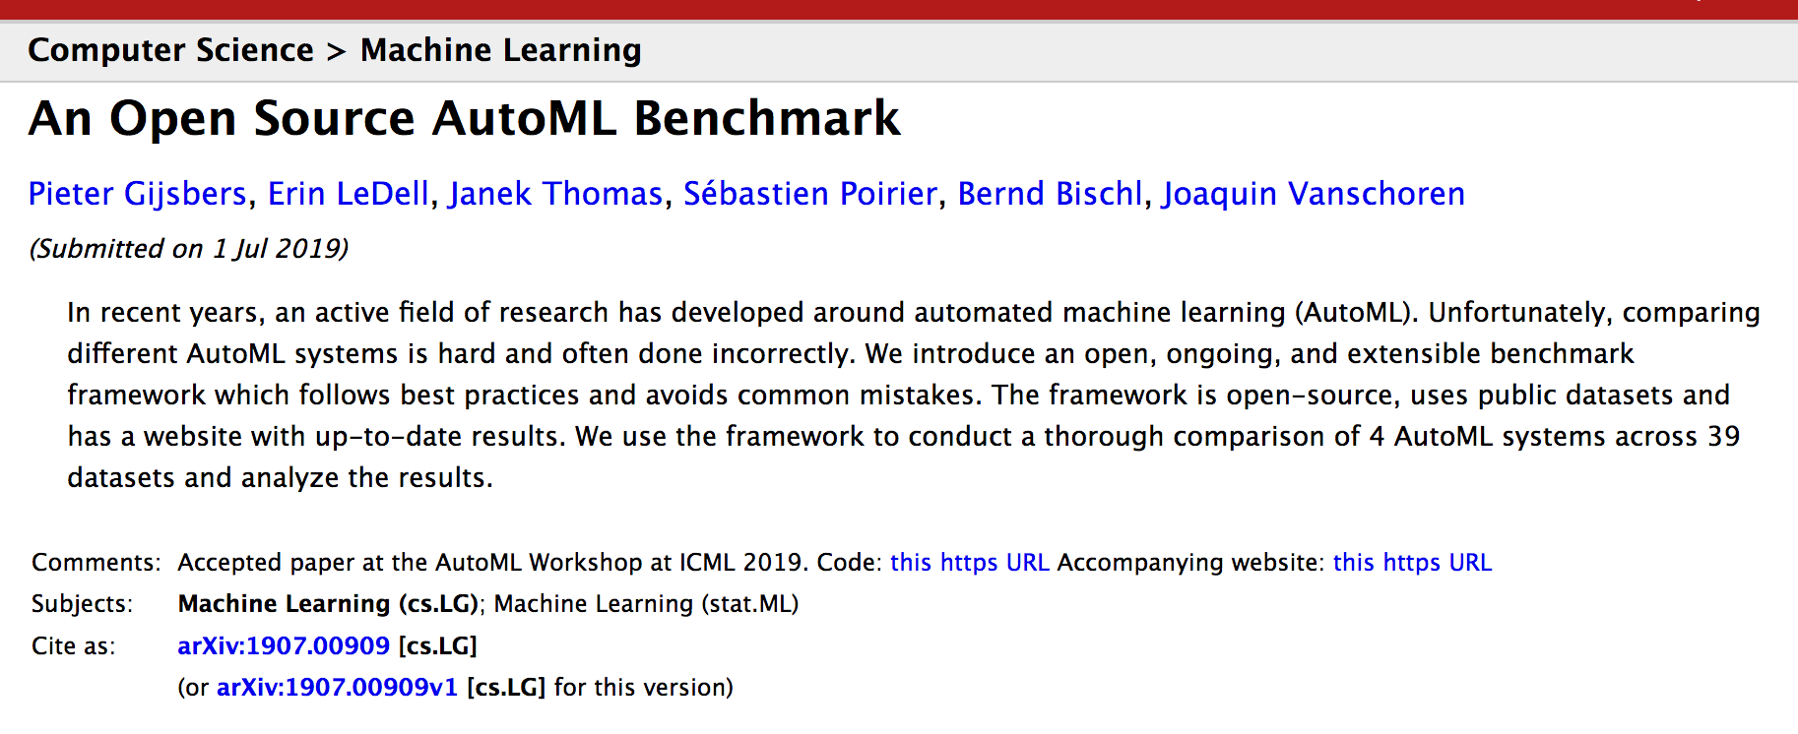
AutoML Benchmarks
ICML/arXiv paper ⬇️ https://tinyurl.com/automlbenchmark

Slide 27
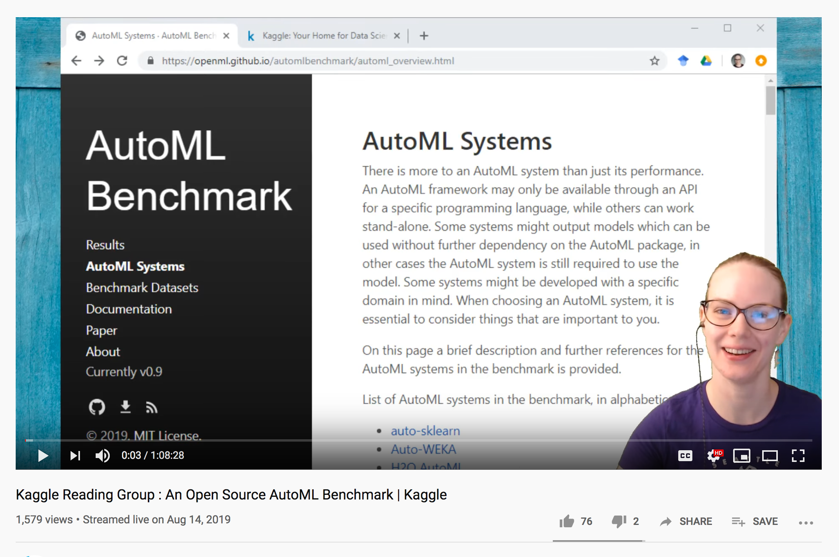
AutoML Benchmarks
https://youtu.be/WlXhpXv9kDU

Slide 28

H2O AutoML Roadmap
Automatic target encoding of high cardinality categorical cols
Better support for wide datasets via feature selection/extraction
Support text input directly via Word2Vec
Variable importance for Stacked Ensembles
Improvements to the models we train based on benchmarking
Fully customizable model list (grid space, etc.)
New algorithms: SVM, GAM

Slide 29

Learn H2O AutoML!
Docs: https://tinyurl.com/h2o-automl-docs
R & Py tutorials: https://tinyurl.com/h2o-automl-tutorials

Slide 30

H2O Resources
Documentation: http://docs.h2o.ai
Tutorials: https://github.com/h2oai/h2o-tutorials
Slidedecks: https://github.com/h2oai/h2o-meetups
Videos: https://www.youtube.com/user/0xdata
Stack Overflow: https://stackoverflow.com/tags/h2o
Google Group: https://tinyurl.com/h2ostream
Gitter: http://gitter.im/h2oai/h2o-3
Events & Meetups: http://h2o.ai/events

Slide 31
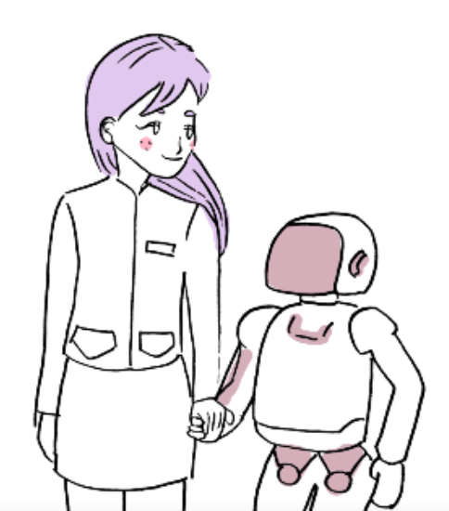
Thank you!
@mtanco on Github, LinkedIn
michelle.tanco@h2o.ai

